Slide 1
Code-A-Thon Coding Interface With Secured Features
Siddaganga Institute of Technology, Tumakuru
Department of Master of Computer Applications
Jeevan G (1SI24MC019)
Guide : Dr. Prashanth G K

Slide 2
Introduction
Online examinations have become a critical component in education and recruitment. Most existing platforms lack flexibility in exam creation, section handling, and real-time evaluation.
This project focuses on enhancing an existing MERN Stack Online Assessment Platform by introducing a robust Admin Panel for dynamic exam management without breaking existing functionality.

Slide 3
Problem Statement
In current online assessment systems:
Exam creation is static and rigid
Section-wise question management is limited
Admins have minimal control over exam structure
Updating systems often breaks existing workflows
Hence, there is a need for a scalable and dynamic admin-driven exam management system.

Slide 4
Objectives
To design a dynamic exam creation system
To allow admins to create multiple sections per exam
To support MCQ and coding questions
To ensure non-breaking integration with the existing platform
To provide secure role-based access for Admin and Users
To improve system scalability and maintainability

Slide 5
Hardware Requirements:
Processor: Intel Core i3 or higher (or equivalent)
RAM: Minimum 8 GB (4 GB minimum, 8 GB recommended)
Storage: Minimum 20 GB free disk space
Display: 1366 × 768 resolution or higher
Network: Stable internet connection
Input Devices: Keyboard and mouse
Software Requirements:
Operating System: Windows 10 / 11 or Linux
Frontend: React.js, HTML, CSS, JavaScript
Backend: Node.js, Express.js
Database: MongoDB
Tools: Visual Studio Code.
Browser: Google Chrome or Edge.

Slide 6
Existing System
Fixed exam structure
Limited admin control
Manual question handling
No dynamic sections
Difficult to scale
Proposed System (Code-A-Thon)
Admin panel for dynamic exam creation
Section-based exams (A, B, C)
Supports MCQ and coding tests
Results stored in MongoDB in real time

Slide 7
Literature Survey
Sl. No. | Author / Platform | Title | Observations
1 | Moodle LMS | Online Learning Management System | Provides exam and course management features but requires complex configuration and offers limited flexibility for custom coding assessments.
2 | Google | Google Forms for Online Exams | Simple and user-friendly but lacks section-wise control, coding question support, and advanced evaluation mechanisms.
3 | HackerRank | Technical Skill Assessment Platform | Strong support for coding assessments but limited customization for academic exam structures and admin-defined sections.
4 | Coursera | Online Assessment Framework | Highly scalable and secure but not suitable for institution-specific exam customization.
5 | Custom MERN-Based Systems | Web-Based Online Examination Systems | Offer high flexibility and scalability, but require careful design to avoid system breakage during feature updates.

Slide 8
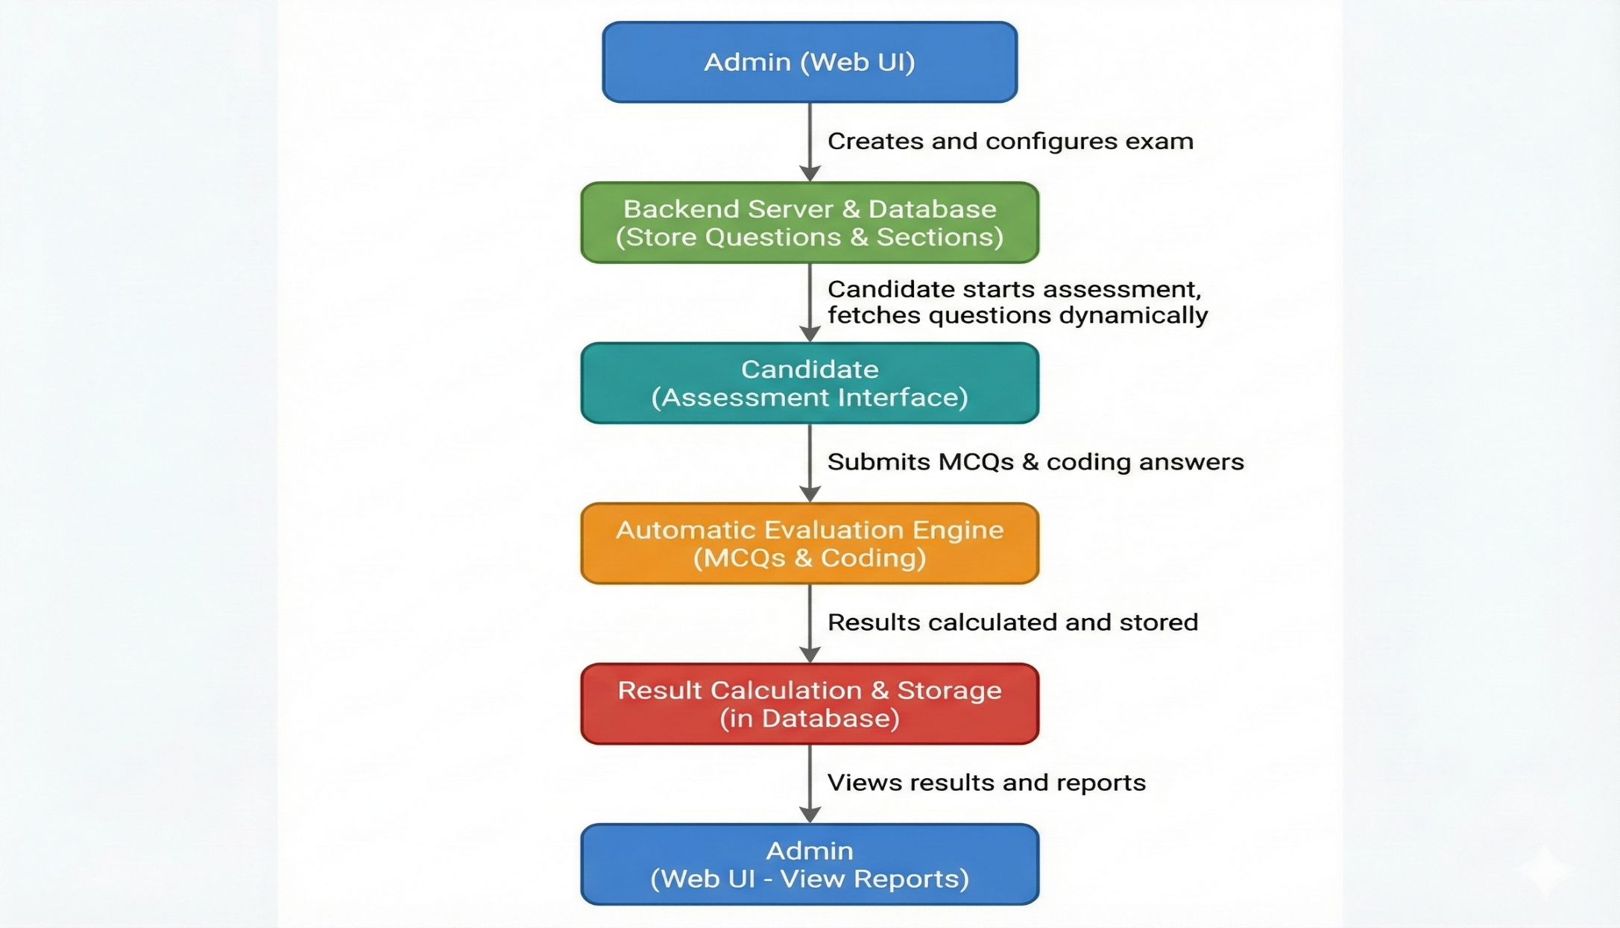
Process Flow

Slide 9
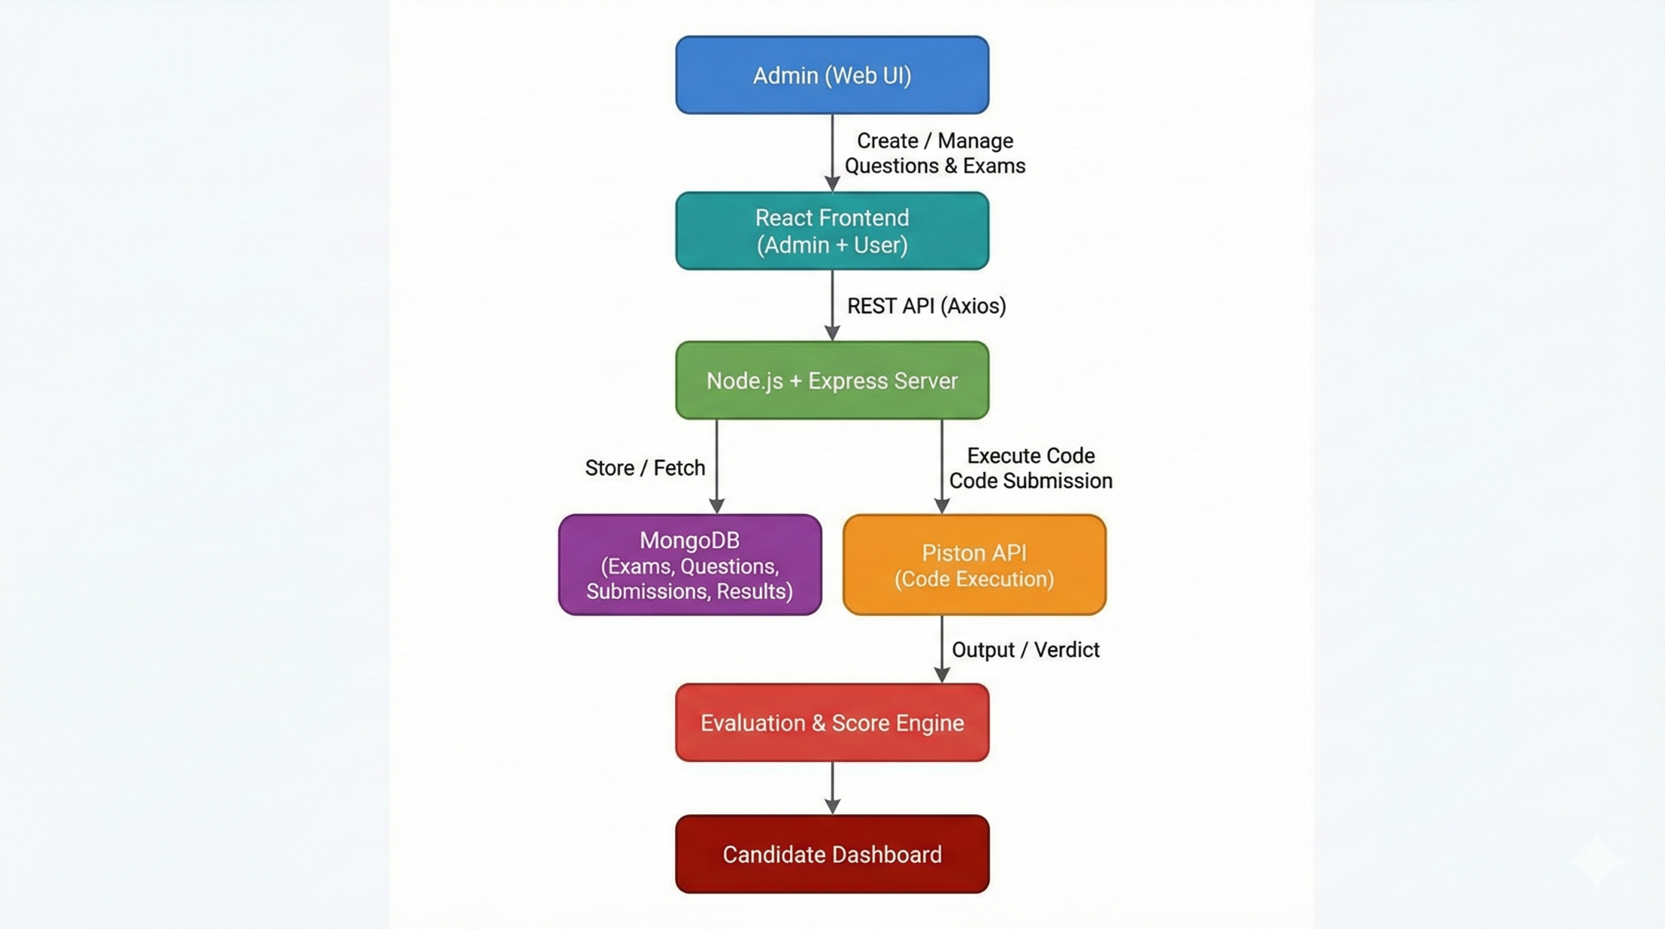
Project Design

Slide 10
Project Implementation
Admin Panel implemented without changing existing UI
New APIs added incrementally
MongoDB schemas extended, not replaced
Frontend integrated using reusable components
Coding answers stored and evaluated separately

Slide 11

Results
This window serves as the introductory display screen for the project. It does not perform any functional operations. Its purpose is to present the project identity, including the institution, department, event name, and project theme. It is shown at the beginning to set context and branding before moving to the actual system modules like Admin Panel and Exam Management.

Slide 12
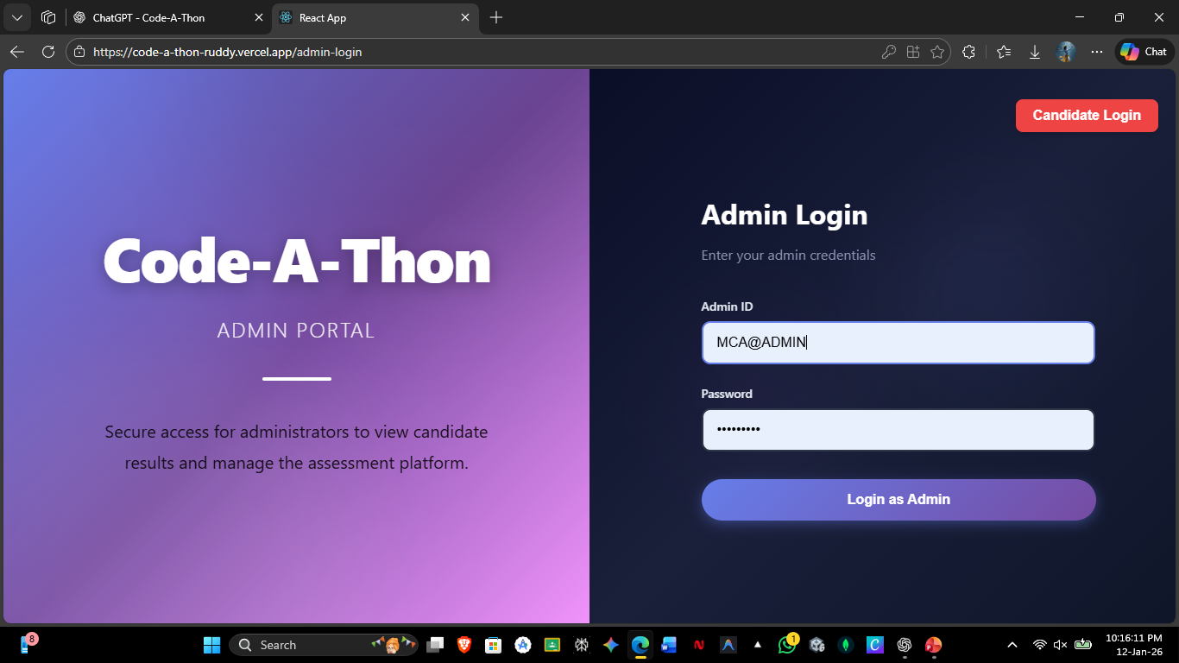
Results
This is the Admin Login screen.
Authorized admins enter their Admin ID and password to access the Admin Portal, where they manage exams, sections, and questions.

Slide 13
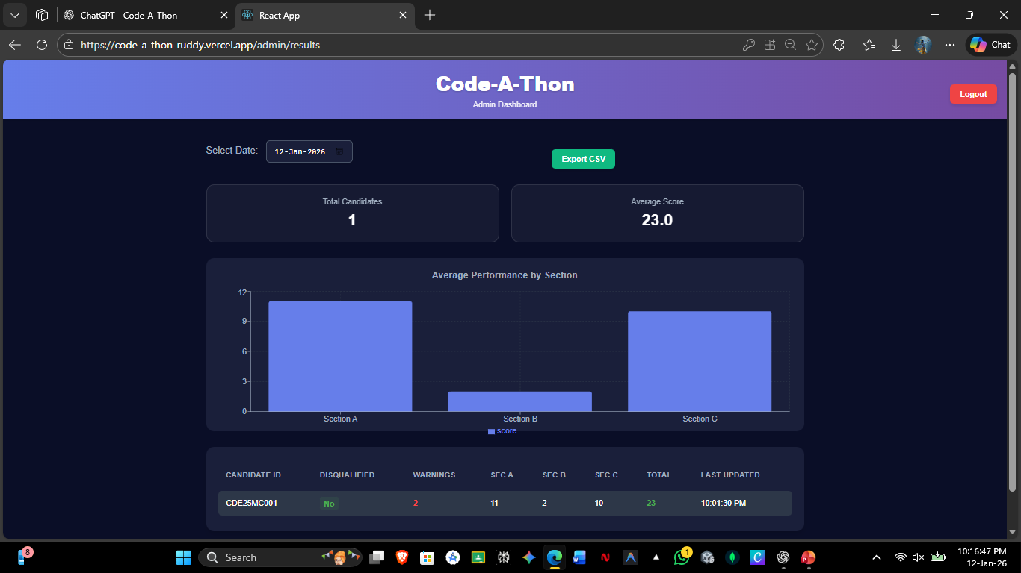
Results
This is the Admin Dashboard.
It displays candidate statistics, average scores, section-wise performance, and detailed results.
Admins can filter by date, export results, and monitor exam performance from this screen.

Slide 14
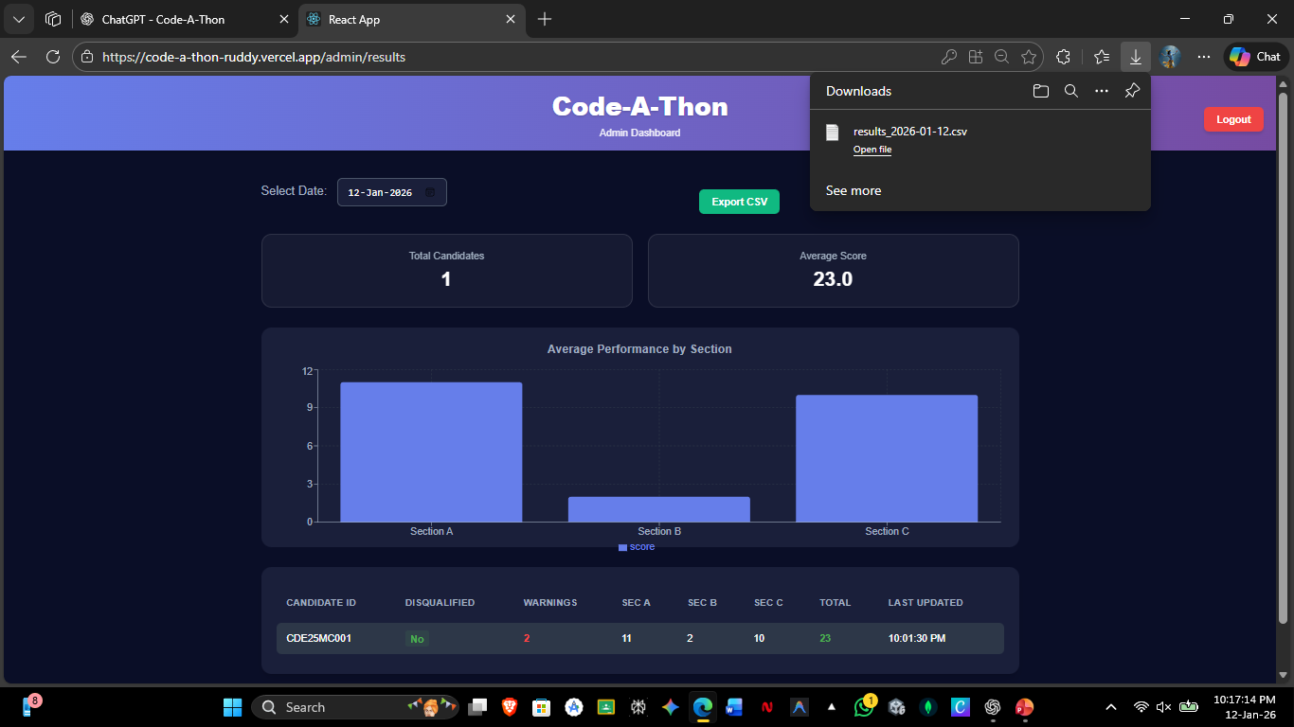
Results
This screen shows the Admin Dashboard with CSV export.
Admins can download candidate results as a CSV file for offline analysis, reporting, or record keeping.

Slide 15
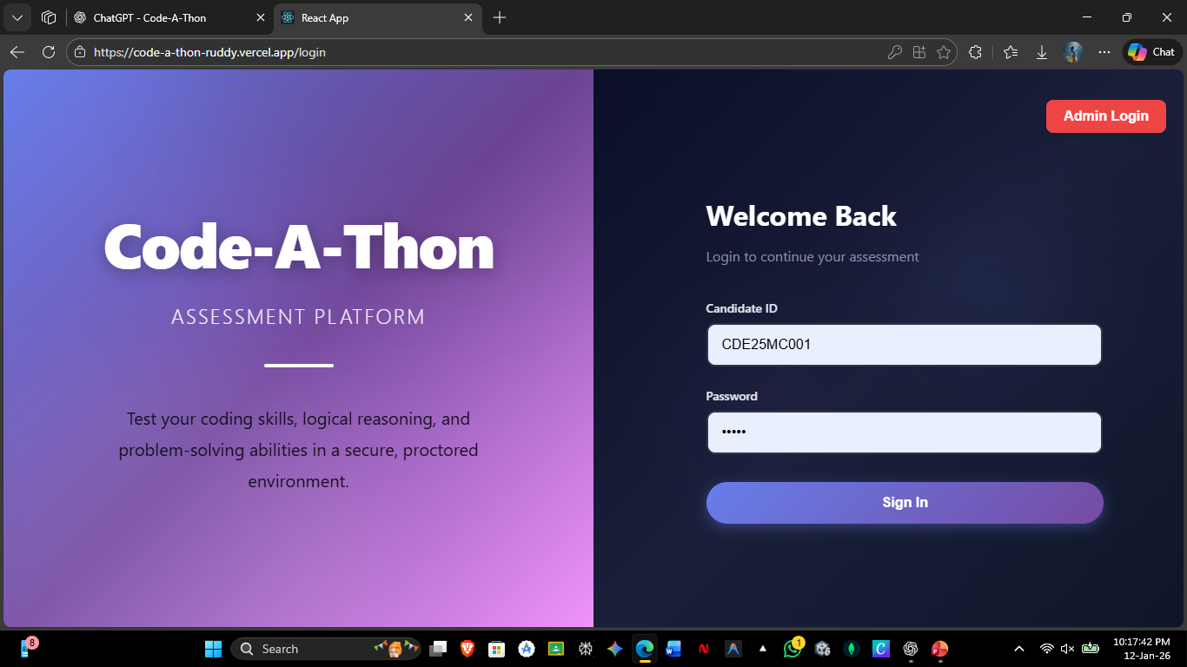
Results
This is the login screen.
Users enter their ID and password to access the system.
Valid users are redirected to their dashboard, and admins can log in to manage exams.

Slide 16
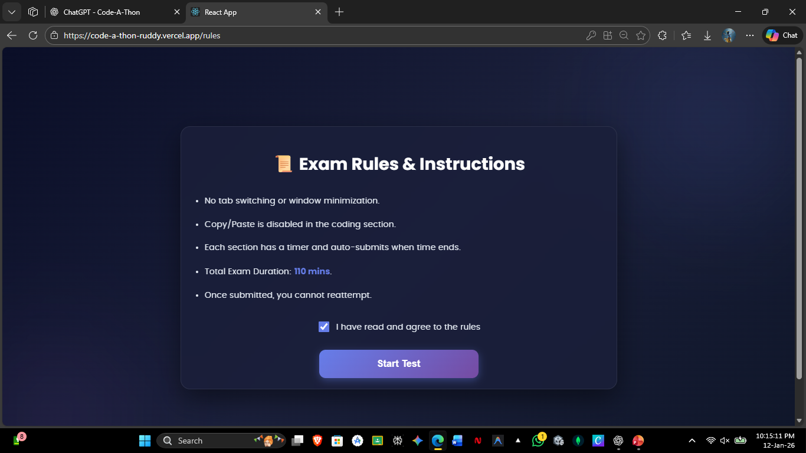
Results
This is the Exam Instructions screen.
It displays rules and exam duration, and allows the candidate to confirm agreement before starting the test.

Slide 17
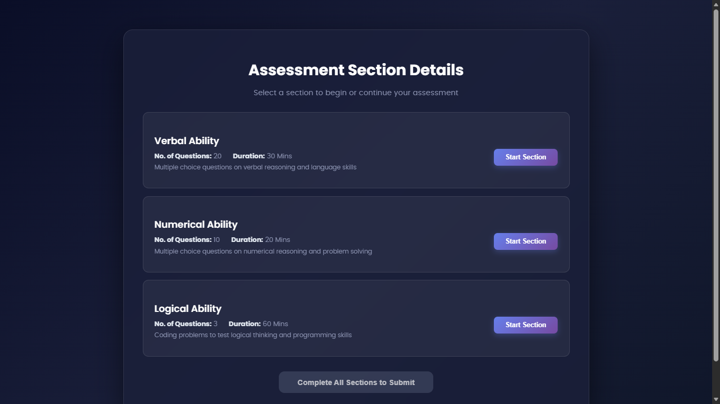
Results
This is the Section Selection screen. Candidates select and start each exam section individually, with defined question count and time limit.
After login, the application switches to full-screen mode to prevent distractions and restrict tab/window switching, ensuring a secure exam environment.

Slide 18
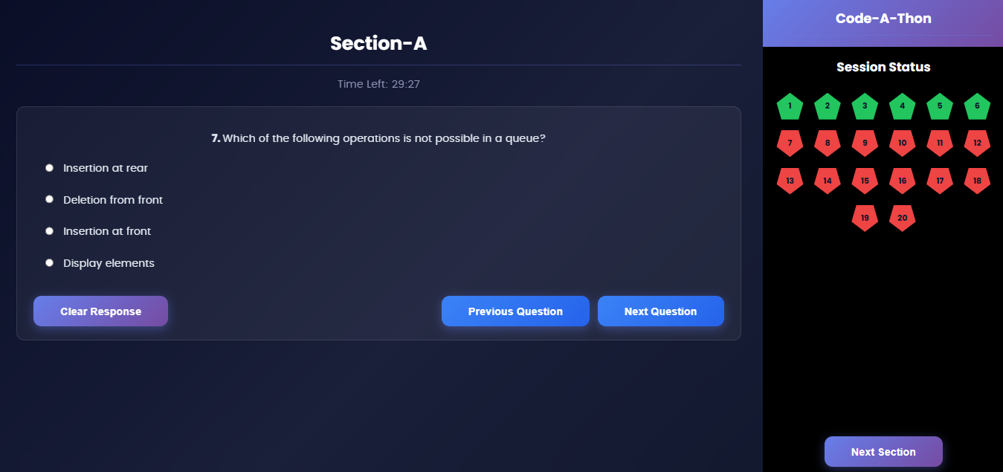
Results
This is the MCQ exam screen for a section.
It displays questions with a timer, allows navigation between questions, and tracks answered/unanswered status until the section is completed.

Slide 19
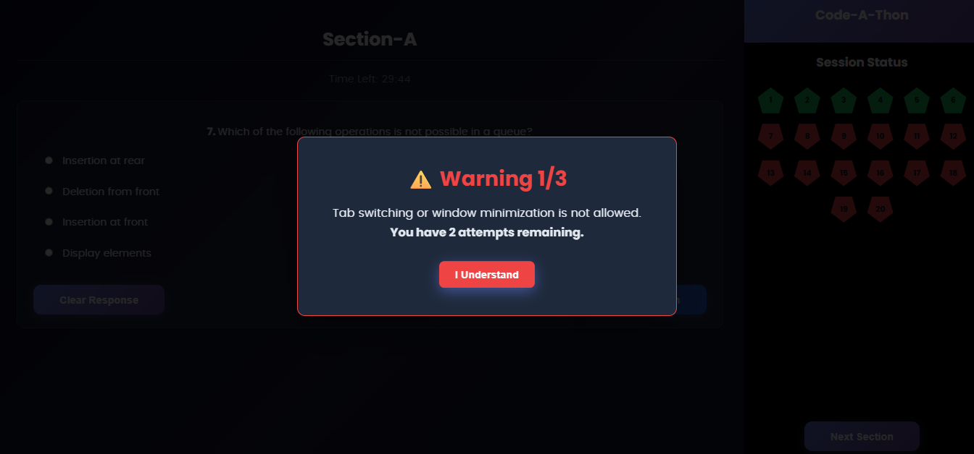
Results
This is the security warning popup.
It appears when the candidate switches tabs or minimizes the window, issues a warning count, and limits such actions to prevent malpractice.

Slide 20
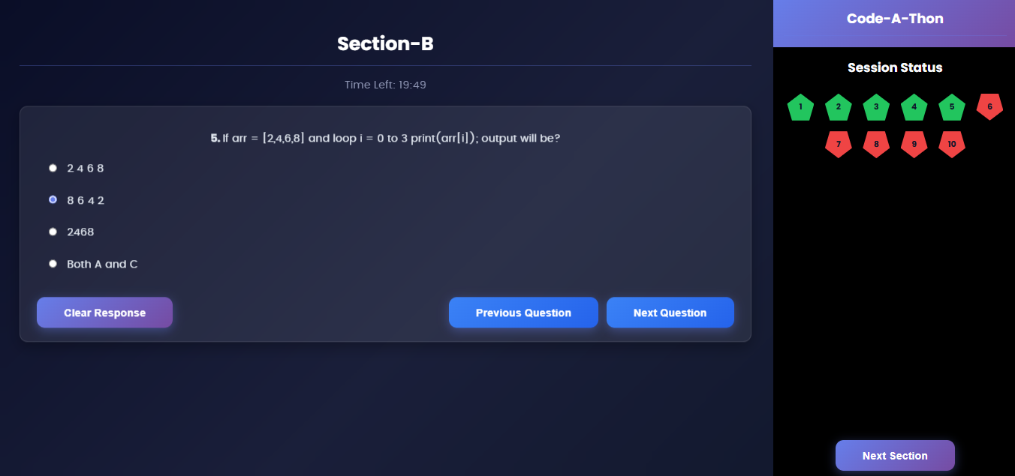
Results
This is the Section-B MCQ screen.
It allows candidates to answer section-specific questions within a time limit and navigate between questions before moving to the next section.

Slide 21
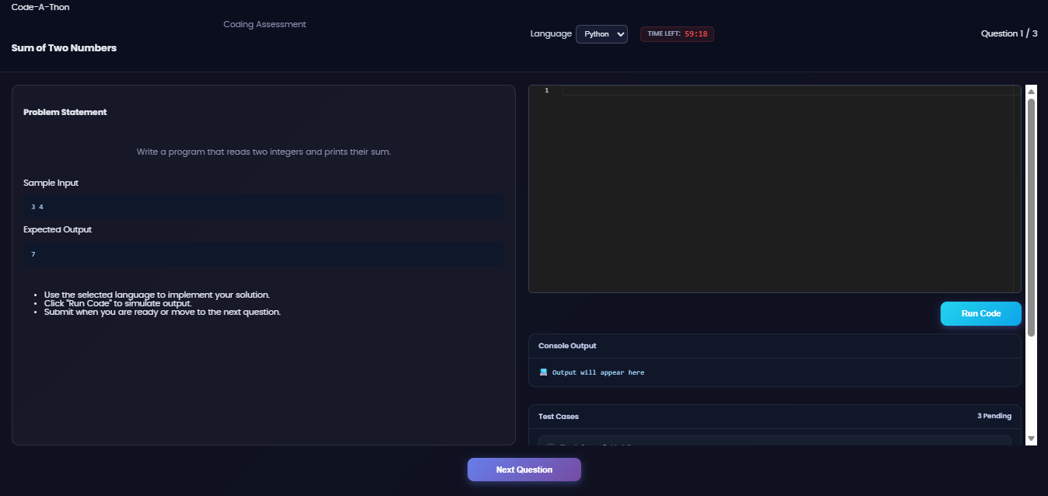
Results
This is the Coding Assessment screen.
Candidates select a programming language, write code, run it to test output, and submit solutions within the given time limit.

Slide 22
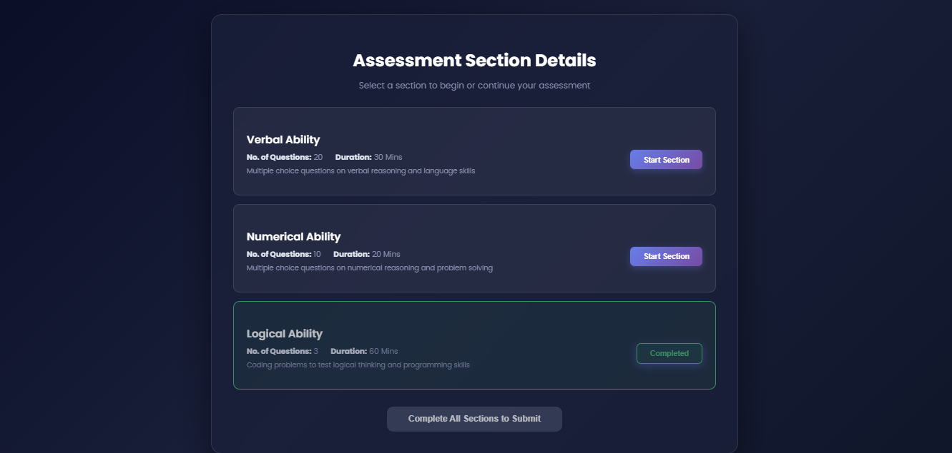
Results
This is the Section Progress screen.
It shows completed sections and allows the candidate to start remaining sections before final submission.

Slide 23
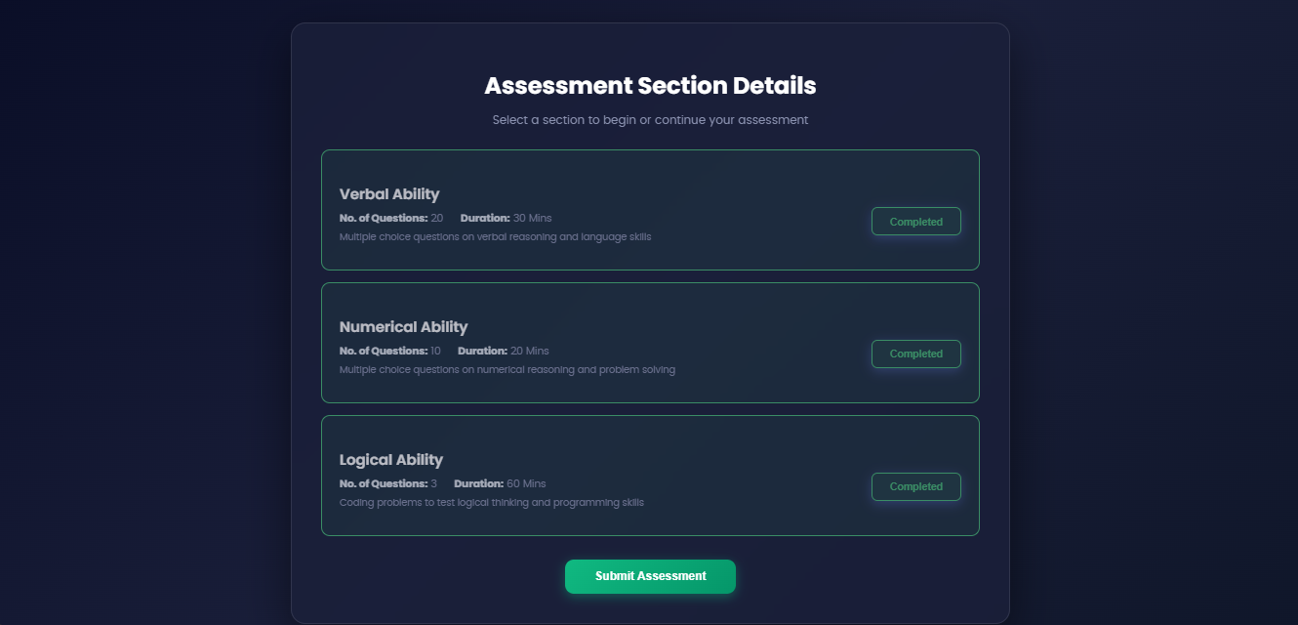
Results
This is the Assessment Completion screen.
It shows all sections as completed and allows the candidate to submit the entire assessment.

Slide 24
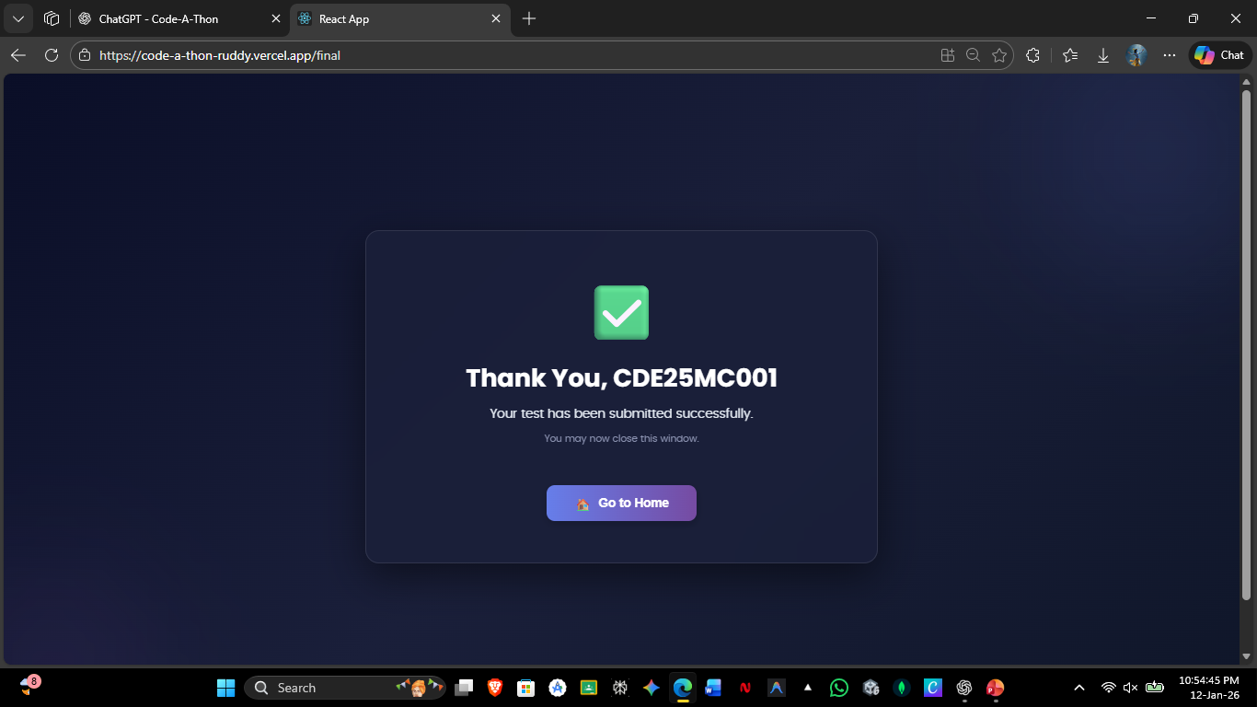
Results
This is the Submission Confirmation screen.
After submission, the candidate’s results are stored in MongoDB with a timestamp.
The system exits full-screen mode, ends the exam session, and the results become immediately available in the Admin Dashboard for monitoring and export.
The “Go to Home” button allows the candidate to navigate back to the home page, completing the assessment flow.

Slide 25
Tools and technologies
Frontend Technologies
React.js
HTML5, CSS3, JavaScript
Backend Technologies
Node.js
Express.js
Database
MongoDB
APIs & Libraries
Piston API (for code execution)
Axios (for API communication)
Development Tools
Visual Studio Code
Git & GitHub
Browser
Google Chrome / Microsoft Edge

Slide 26
Conclusion
The Code-A-Thon Online Assessment Platform successfully delivers a secure, scalable, and efficient examination system using the MERN stack. The platform supports dynamic exam creation, section-wise assessments, MCQ and coding evaluations, and real-time result processing without compromising system stability.
Key strengths of the system include:
Role-based access with a dedicated Admin Panel
Secure exam environment using full-screen enforcement and activity monitoring
Automated result storage in MongoDB with accurate timestamps
Real-time analytics and CSV export for administrative review
Modular and extensible architecture, enabling future enhancements without breaking existing functionality
Overall, the project demonstrates a production-ready assessment solution suitable for academic institutions, recruitment drives, and competitive coding events, while maintaining high standards of security, performance, and maintainability.

Slide 27


